Slide 1
Medication Management and Error Reduction System.
Presenters
Ben morehead
Jade Sleiman
Mark villamayor
MILLICENT WANYEKI

Slide 2
Problem Statement and Project Goals
Every year, medication errors cause significant morbidity and mortality. At least one death every day and 1.3 million people are affected annually in the United States according to FDA.
Project Goals
Reduce Medication Errors - Implement real time alerts to prevent dispensing errors.
2. Enhance Medication Management - Providing a comprehensive dashboard for monitoring and alerts on patient medication schedules.
3. Improve Patient-Provider communication - Enable access to update medication information and interaction warnings.

Slide 3
Milestone 1.0 Features
Key Features:
External Drug Interaction Information for Medical Providers (Medical Provider User Story #1)
Automatic Drug Interaction Checks for Medical Providers (Medical Provider User Story #2)
Medical Provider Login (Medical Provider User Story #4 without the messaging system)
Medical Provider Barcode-Based Medication Management System (Medical Provider User Story #7)
Administrator Implementation of 2FA (Administrator User Story #1)
Administrator Medication Verification (Administrator User Story #2)
Administrator Role-Based Access Control (RBAC) Management (Administrator User Story #3)

Slide 4
Stakeholder and Benefits
Stakeholders:
Patients will be empowered with tools to manage their health by accessing personal medical histories and medication information.
Medical providers will be equipped with advanced tools to ensure patient safety and effective medication management.
Administrators will maintain system integrity and functionality, ensuring it serves all users effectively.
Benefits
For Patients: Increased safety and awareness of their treatment plans.
For Medical Providers: Tools to reduce error rates and enhance patient care effectiveness.
For Healthcare System: Reduced overall healthcare costs through prevention of medication errors.

Slide 5
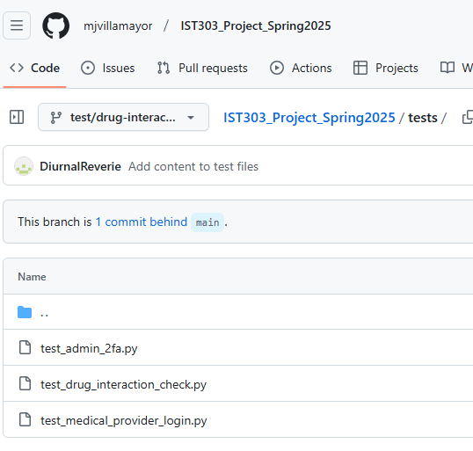
Testing
These comprehensive test suites work together to ensure your medication management system maintains the highest standards of security, safety, and reliability. The authentication tests protect patient data by verifying only authorized providers can access the system, the drug interaction tests help prevent dangerous medication combinations that could harm patients, and the administrator security tests add an extra verification step for those with the highest system privileges. By implementing these automated tests, we're providing continuous validation that critical safety and security features function correctly, even as we add new capabilities to the system in the future.
## General Notes - All tests follow the project's testing standards and patterns - Tests are designed to work with the planned API structure - No actual API calls are made; all external dependencies are mocked - Tests will help guide the implementation of these security-critical features

Slide 6
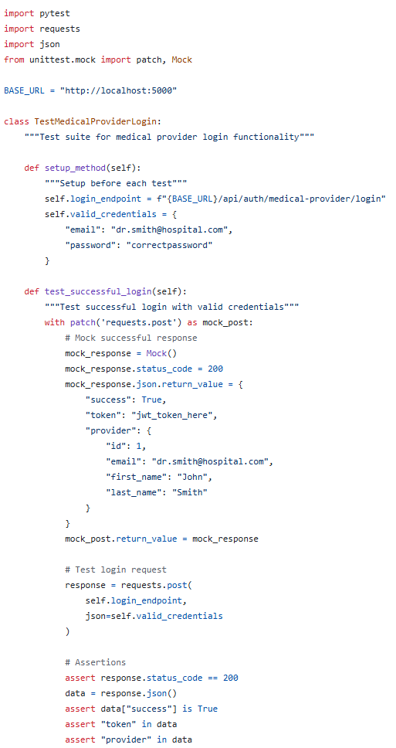
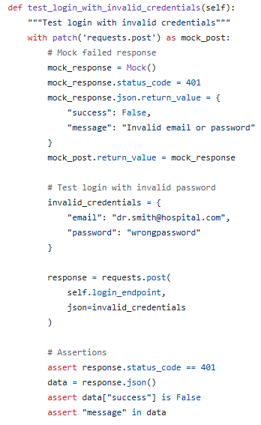
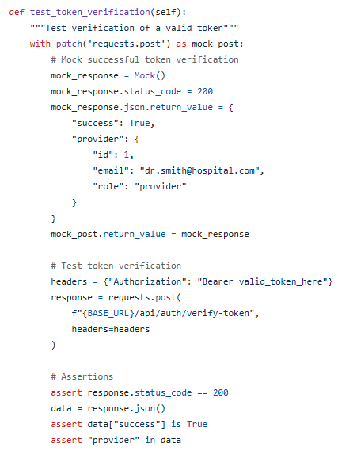
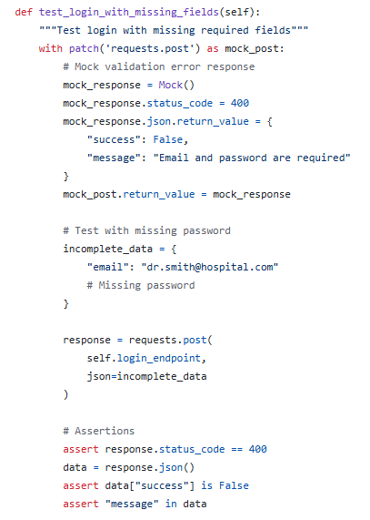
Medical Provider Login Tests
The medical provider login tests ensure that only authorized healthcare providers can access patient information and medication records. These tests verify that the system properly authenticates providers with valid credentials while blocking unauthorized access attempts.
## Medical Provider Login Tests - **Purpose**: Added test suite for medical provider authentication functionality - **Test Coverage**: - Successful login with valid credentials - Failed login with invalid credentials - Validation for missing required fields - JWT token verification - **Implementation Details**: - Used pytest and unittest.mock for testing - Set up mocks to simulate API responses without requiring a running server - Covered both positive and negative test cases - **Future Work**: These tests will validate the upcoming authentication endpoints

Slide 7
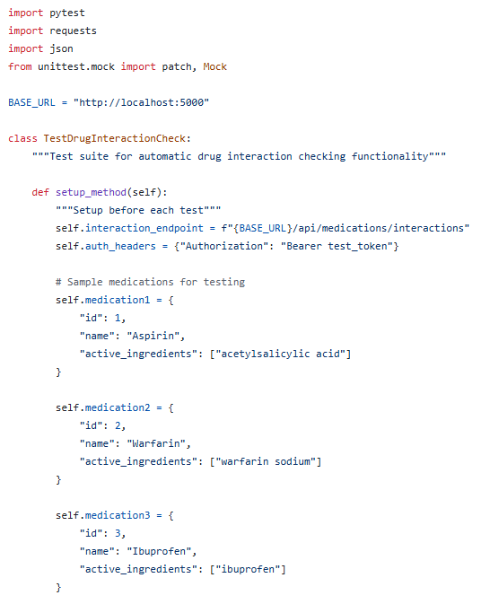
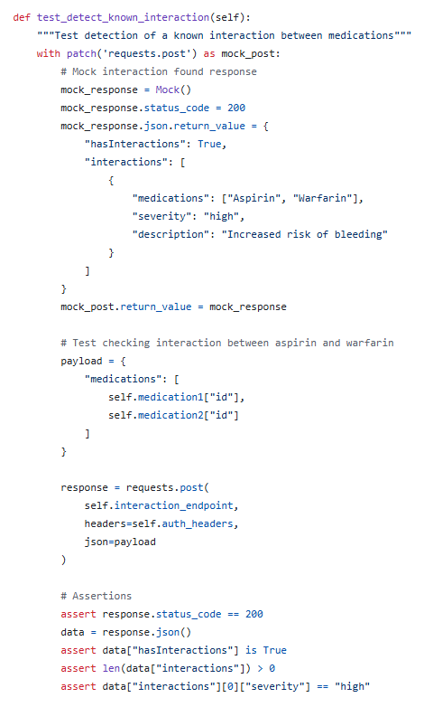
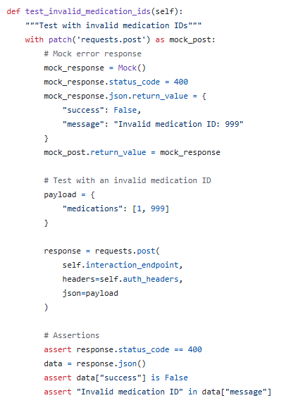
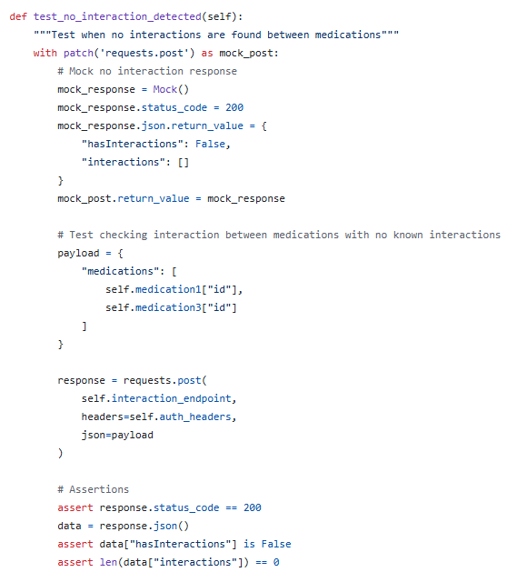
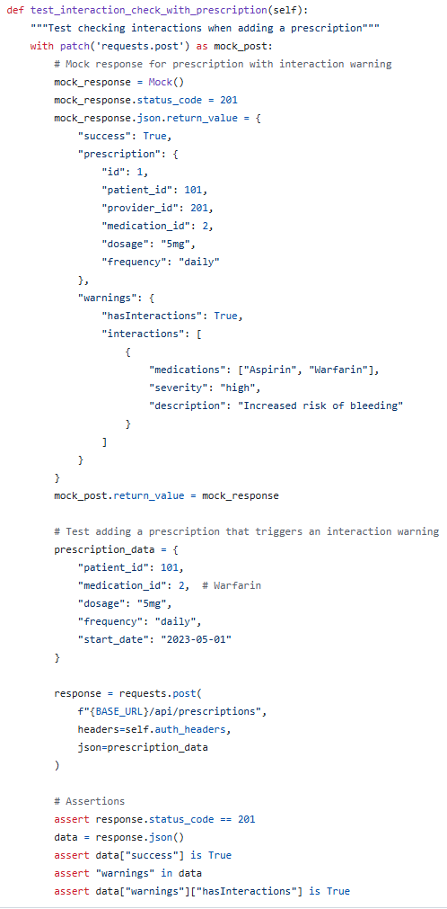
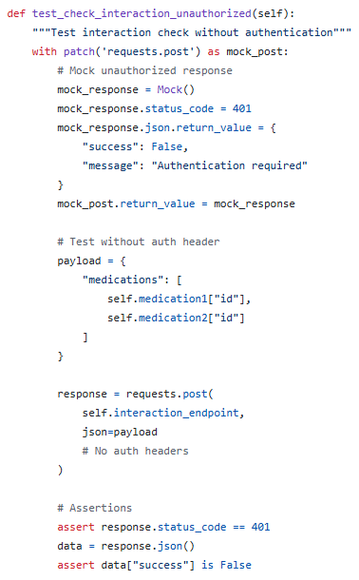
Drug Interaction Check Tests
The drug interaction check tests validate that the system properly identifies potentially dangerous combinations of medications before they're prescribed to patients. These tests ensure that providers receive clear warnings about medication conflicts, helping prevent adverse reactions and improving patient safety.
## Drug Interaction Check Tests - **Purpose**: Added test suite for automatic drug interaction detection system - **Test Coverage**: - Detection of known drug interactions - Handling of non-interacting medications - Response to invalid medication IDs - Unauthorized access attempts - Interaction warnings during prescription creation - **Implementation Details**: - Structured tests to validate interaction severity ratings - Mocked API responses to simulate database results - Added test cases for integration with prescription workflow

Slide 8
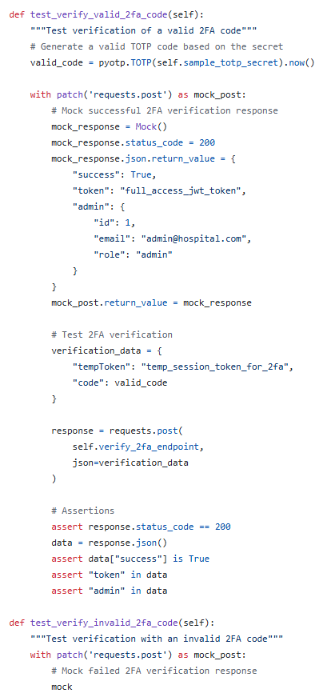
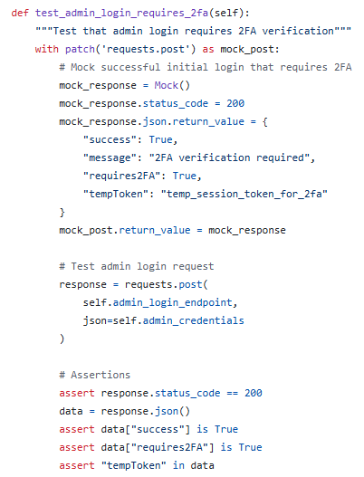
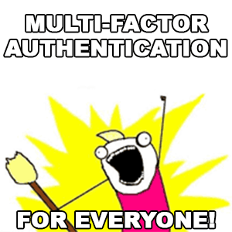
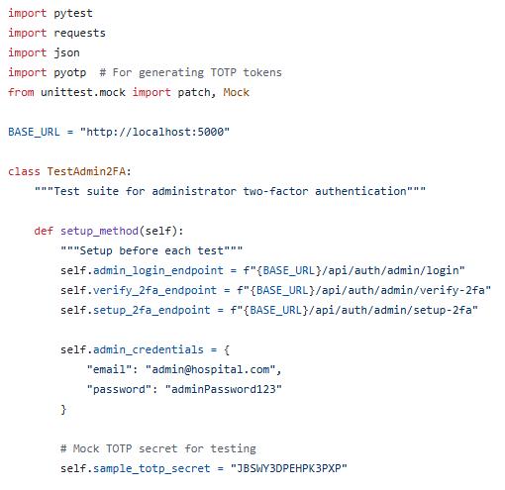
Administrator Implementation of 2FA Testing
The administrator two-factor authentication tests confirm that system administrators must verify their identity through two separate methods before gaining access to sensitive system controls. This additional security layer protects against unauthorized administrative access even if passwords are compromised.
## Admin 2FA Tests - **Purpose**: Added test suite for administrator two-factor authentication - **Test Coverage**: - Initial login requiring 2FA verification - Successful verification with valid 2FA code - Rejection of invalid 2FA codes - Handling of expired verification attempts - **Implementation Details**: - Used pyotp library to generate and validate TOTP codes - Tested the complete 2FA workflow from login to verification - Covered both success and failure scenarios

Slide 9
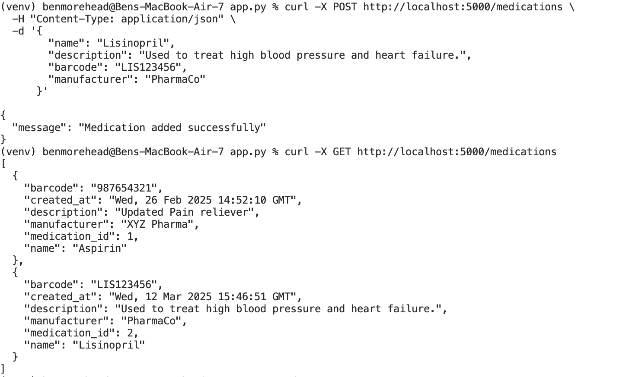
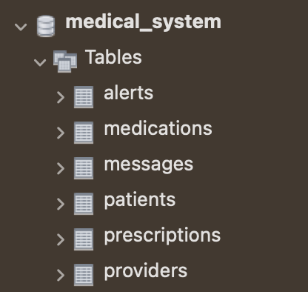
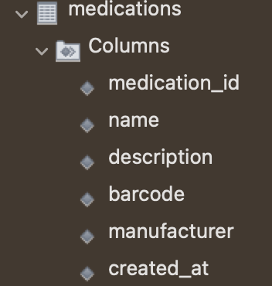
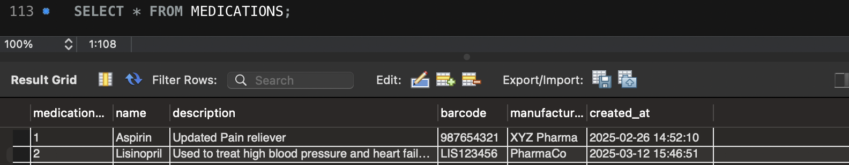
Medical Provider Barcode-Based Medication System with Testing but without UI
Medical Provider Barcode-Based Medication System without UI and Testing
Implement CRUD functionality for medications (2 days)
Develop the API to update medication lists dynamically (1 day)
Test update functions and permissions (1 day)

Slide 10
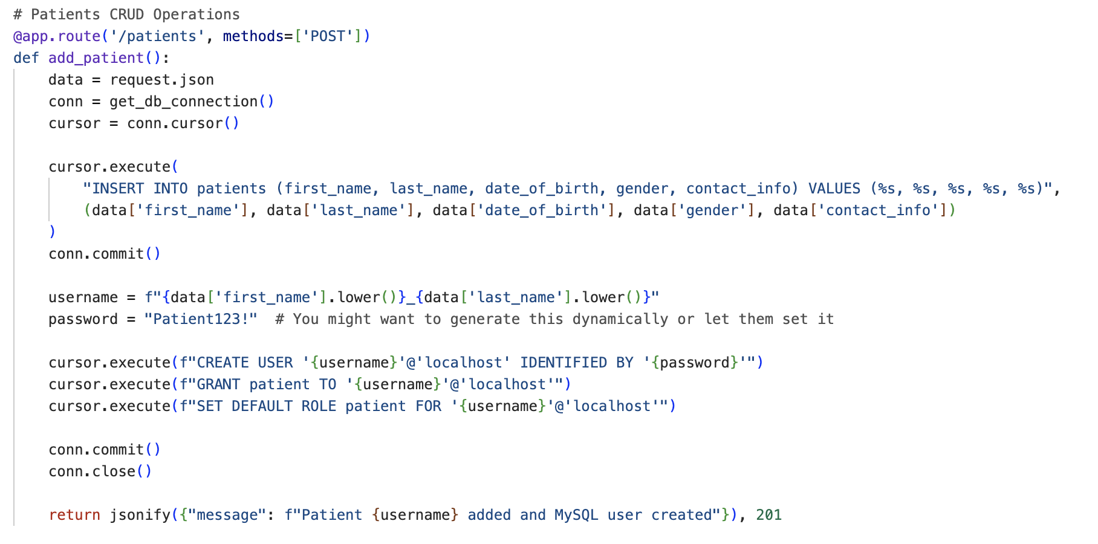
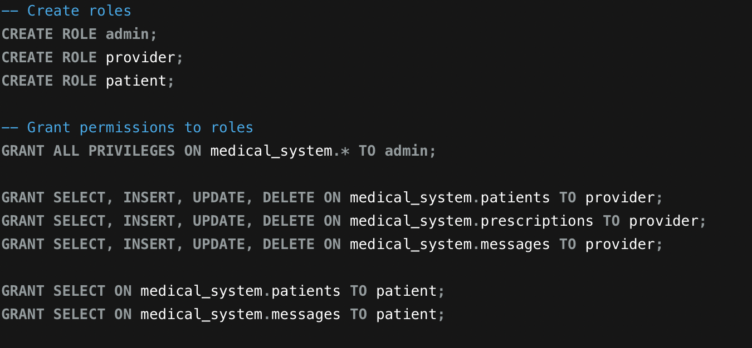
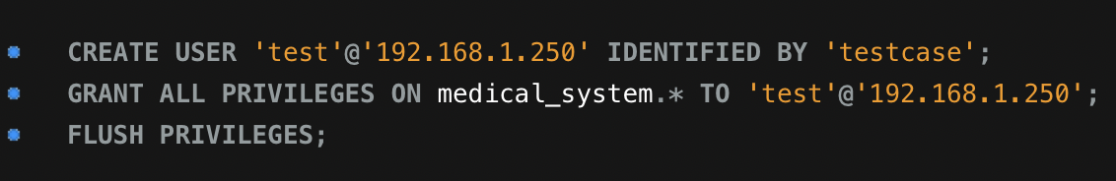
Administrator RBAC Management
Administrator RBAC Management (5 days)
Define user roles in the database (1 day)
Implement access control across application system (2 days)
Test access restrictions of roles (1 day)

Slide 11
Pushed to Milestone 2 :
As a patient, I want to view my own individual medical history so that I am aware of how medical providers review my overall profile. (Estimate: 4 days)
As a patient, I want to view my past and current medication prescriptions as well as receive dashboard alerts for missed medication and potential prescription renewals so that I can be proactive about my own health and medications. (Estimate: 5 days)
As a patient, I want to log in to my own portal that features demographic characteristics of myself for a holistic profile, along with being able to access my own medical history, so that there is transparency about myself and my health. (Estimate: 6 days)
As a medical provider, I want to receive and send alerts for missed medication dispensements of given patients, along with being able to log my own requests for medication restocks, so that patients' prescribed medication treatments are not interrupted. (Estimate: 4 days)
As a medical provider, I want to access notes from other healthcare personnel, so that no information is lost between personnel when changing shifts. (Estimate: 4 days)
As a medical provider, I want to access and edit the database of patients' medical histories that includes past diagnoses, past and current medication prescriptions, and medical procedures among others so that there is a comprehensive profile of each patient. (Estimate: 4 days)

